Slide 1
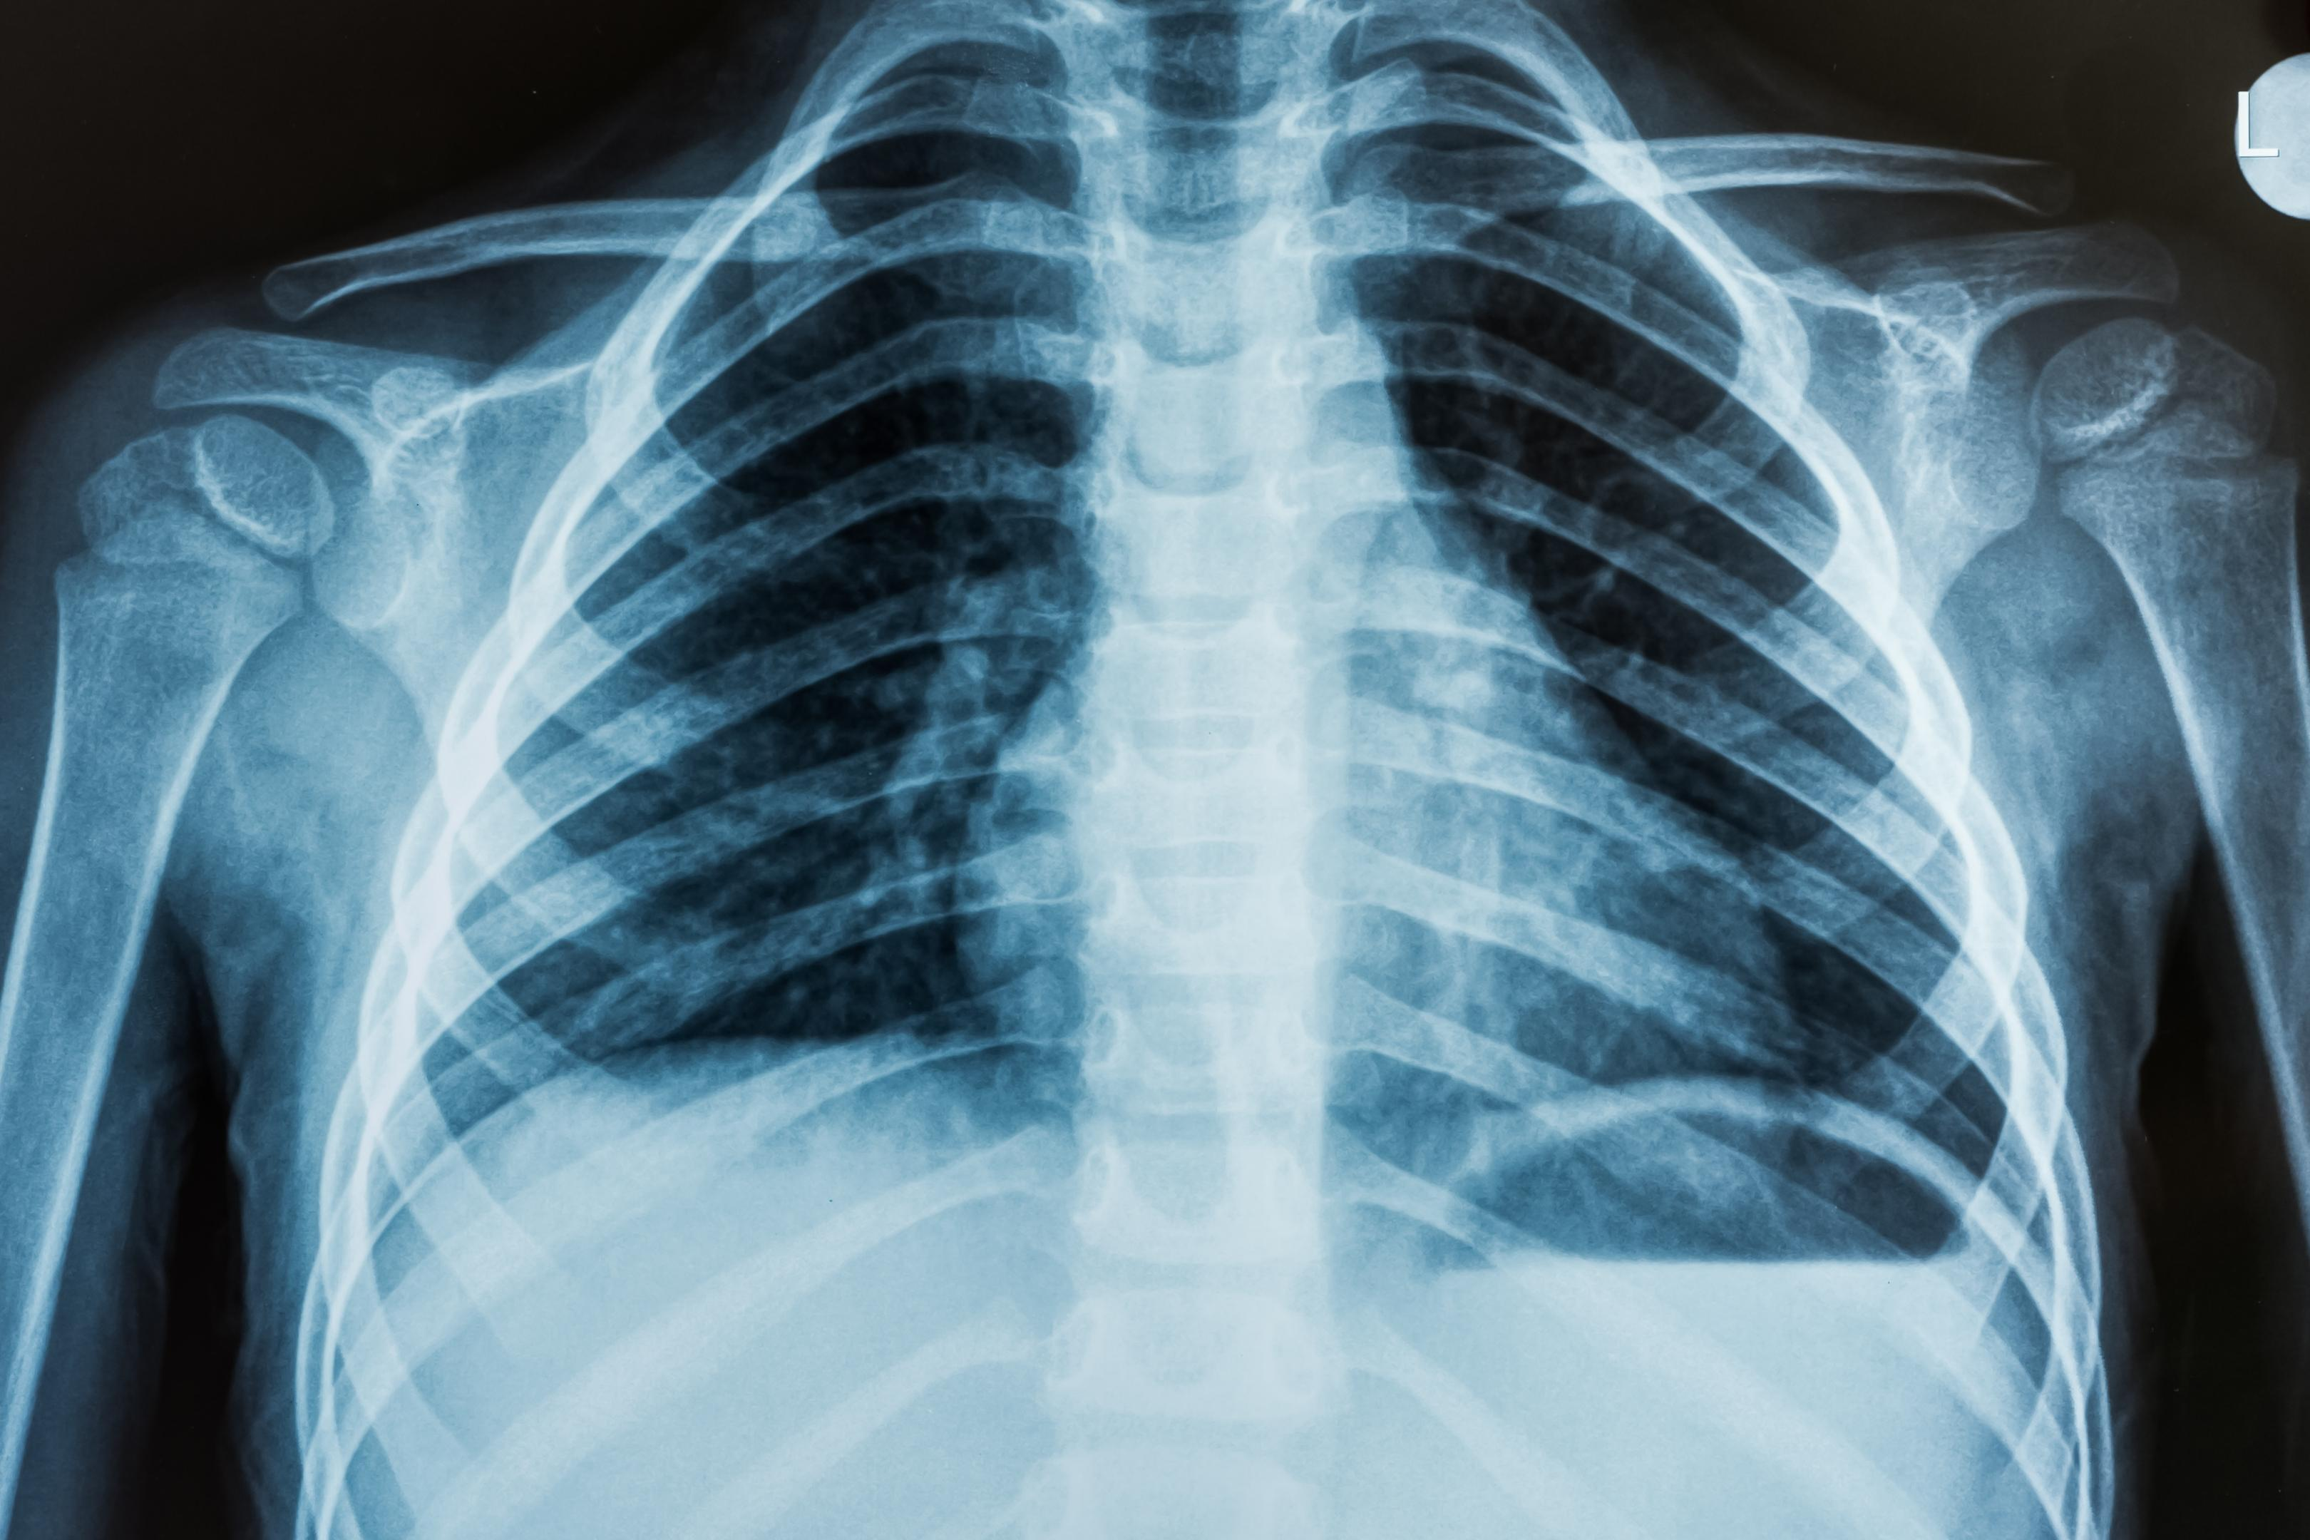
Distinguishing Pneumonia
with X-ray of Chest
via Deep Learning
made by Xiao-Ying Zhuang

Slide 2
Outline
Summary
Training
Application
Problem
Procedure
Demo (flask)
Data Source
Solution
Demo (tkinter)
Preprocessing
Target
Training Models
Conclusion
Criteria
Flow Diagram
Future Outlook
Comparison
Reference
Result

Slide 3

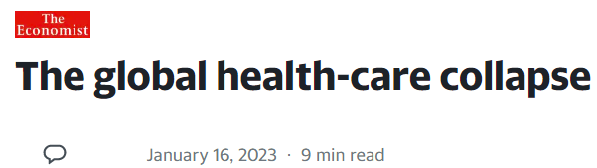
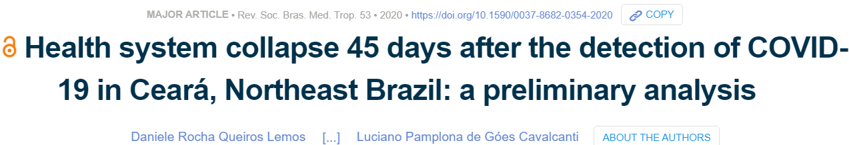
Problem
The outbreak of the Covid-19 in late 2019 triggered a global epidemic of infectious diseases and paralyzed the global healthcare system.
When a patient with suspected Covid-19 is sent to the hospital, it is necessary to quickly judge its severity so that the amount of medical treatment can be properly allocated to prevent severe patients from running out of resources.

Slide 4
Solution
In practice, the diagnosis of pneumonia depends on the following things: ▲ Clinical symptoms (cough, sputum, fever, pain) ▲ Medical Images (Abnormal shadowing in the chest X-ray Image)
However, the interpretation of chest X-ray images will be more time-consuming. Besides, the more severe the lesion is, the easier it is to interpret. In other words, if the lesion is very small, there may be interpretation errors. And poor exposure imaging may also affect interpretation.
By using deep learning model (CNN), the problems mentioned above can be solved quickly and precisely. Because CNN model can“read” X-ray images pixel by pixel, which is almost impossible to human beings.
X-ray
Image
Prediction
Model
Normal/
Pneumonia

Slide 5

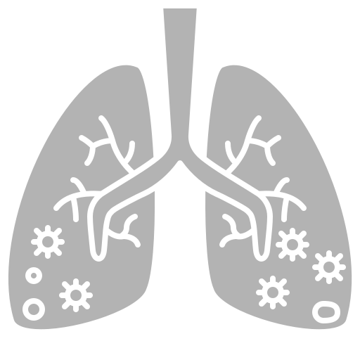



Target
Pneumonia…
Becteria
X-ray Image
Virus
Normal!

Slide 6
Flow Diagram
Image
Model (N/P)
Normal
Pneumonia
Bacteria
Model (B/V)
Virus

Slide 7
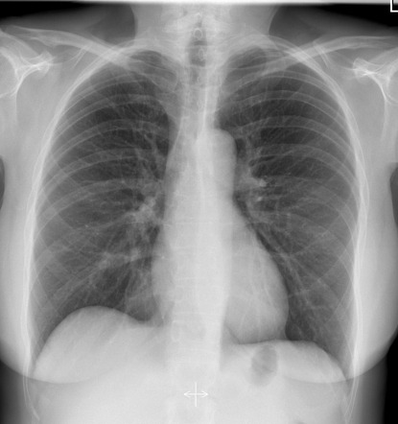
Precedure
Data
Preprocessing
Training
Label
Normal
Pneumonia
Virus
Bacteria
Rotation_range
Width_shift_range
Height_shift_range
Zoom range
resize
weight
Epoch
batch size
EarlyStopping
ModelCheckpoint

Slide 8
Data Source - from kaggle
Split 20%
To
validation

Slide 9
Preprocessing
rotation_rang = 30
width_shift_range = 0.05~0.2
height_shift_range = 0.05~0.2
zoom_range = 0.2
horizontal_flip = false

Slide 10
Training Models
Weight = {0:3,1:1}
Input_shape = 128~666
Epoch = 30~45
Batch size = 32~64
Model_monitor = Recall
ReduceLROnPlateau
Factor = 0.2~0.3
Early_stopping =
monitor = loss
Min_delta = 1e-5~1e-2

Slide 11
Criteria
Actual
True
False
TP | FP
FN | TN
True
Prediction
False
Accuracy = ( TP + TN )/( TP + FP + FN + TN )
Precision = TP / ( TP + FP )
Recall= TP / ( TP + FN)
F1 score = 2 / (Precision⁻¹ + Recall⁻¹)

Slide 12
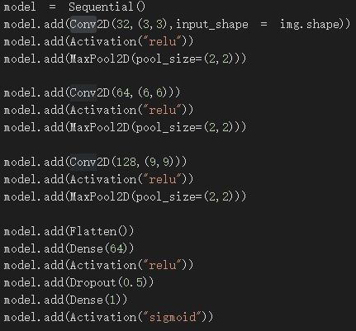
Training Models - Self-build CNN
Conv2D (32 ,(3,3))
Flatten
Activation : relu
Dense(64)
MaxPool2D (2,2)
Activation : relu
Conv2D (64 ,(6,6))
Dropout 50%
Activation : relu
Dense(1)
MaxPool2D (2,2)
Activation : sigmoid
Conv2D (128 ,(9,9))
Activation : relu
MaxPool2D (2,2)

Slide 13
Training Models - Keras applications
Both ResNet50V2 and ResNet152V2 are versions of ResNet that have improved the vanishing gradient problem when dealing with deep networks.
InceptionV3 combines multiple convolution operations (such as 1x1, 3x3, and 5x5 convolutions), having pooling layers of different sizes and types to improve model efficiency.
MobileNet is a lightweight network architecture using depthwise separable convolutions that can run on mobile devices with limited hardware.
EfficientNetV2S is a version of EfficientNet, which is mainly designed based on the combination of network depth, width and resolution.

Slide 14
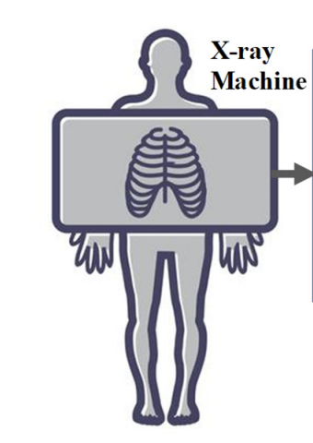
Ensembling
Self-build CNN
Self-build CNN
Pneumonia
X-ray
X-ray
InceptionV3
Mobile Net
Bacterial pneumonia
Viral pneumonia
N / P
Prediction
B / V
Prediction
Pneumonia
ResNet152V2
ResNet50V2
X-ray data
EfficientNetV2S
ResNet152V2
Normal
Congratulations!!

Slide 15
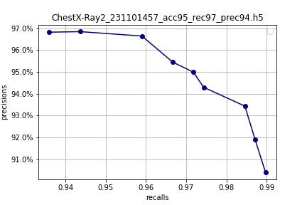
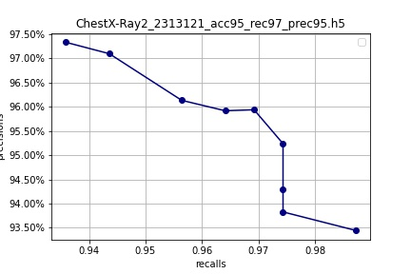
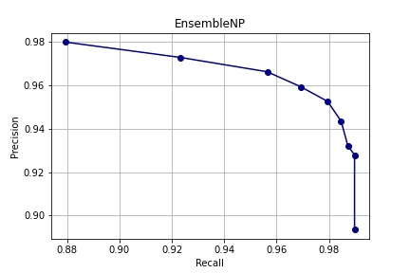
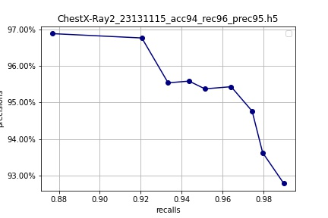
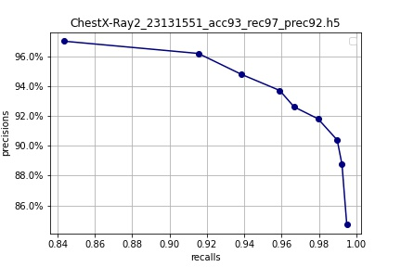
Comparison – PR curve
AP = 0.9455
AP = 0.9548
inceptionV3
EfficientNetV2S
AP = 0.9475
Ensembled
AP = 0.9522
AP = 0.9220
ResNet152V2
Self-build CNN

Slide 16
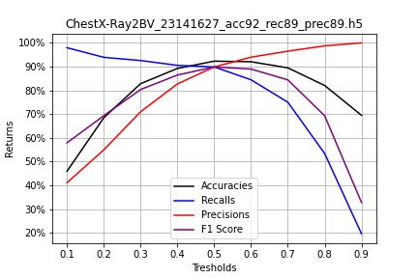
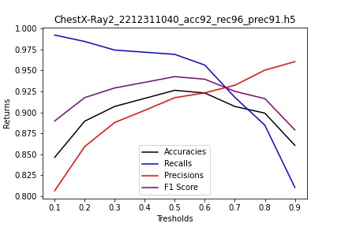
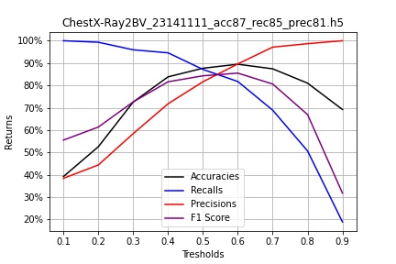
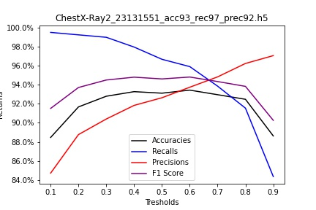
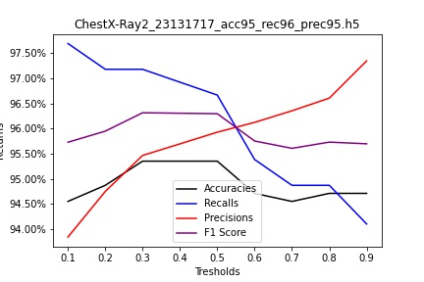
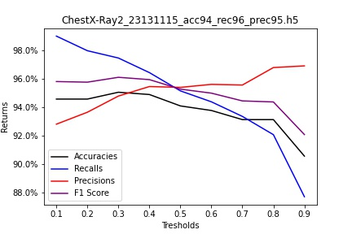
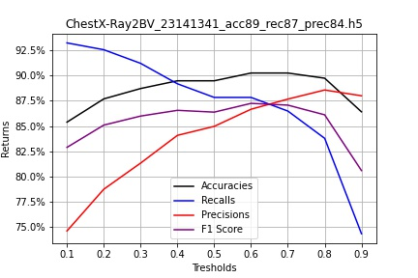
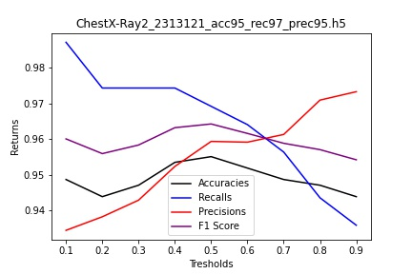
Comparison – best threshold finding
Notes:
本研究透過深度學習針對胸部X光影像進行影像辨識研究，使用來自於Kaggle的胸部X光影像數據庫，包含正常的肺和一般肺炎的胸部X光影像，透過四種模型來進行X光影像的預測，接著將CNN、InceptionV3、ResNet152V2 、 EfficientNetV2S模型預測的結果得出最終結論。EfficientNetV2S評估指標比另外三個模型效果好，其準確率、精準度、召回值分別為95.5%、95.7%以及97.2%，可以將此預測結果作為輔助肺炎檢測與醫生診斷的依據。

Slide 17
Result
Pneumonia
Normal

Slide 18
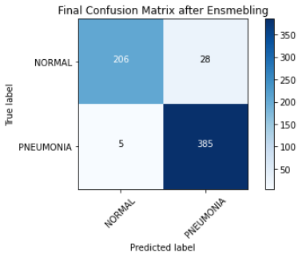
Result
Pneumonia
Normal

Slide 19
Result
Pneumonia
Normal
Pneumonia…
Becteria
X-ray Image
？
Virus
Normal!

Slide 20
Data Source - from kaggle

Slide 21
Preprocessing
rotation_range=15 ~ 30
width_shift_range = 0.05~0.2
height_shift_range = 0.05~0.2
zoom_range = 0.1 ~ 0.4
horizontal_flip = false

Slide 22
Training Models
Weight = {0:1, 1:2}
Input_shape = 224~299
Epoch = 30~45
Batch size = 32~64
Model_monitor = accuracy
EarlyStopping
monitor = loss
ReduceLROnPlateau
factor = 0.2~0.3
min_delta = 1e-3~1e-5

Slide 23
Criteria
Actual
True
False
TP | FP
FN | TN
True
Prediction
False
Accuracy = ( TP + TN )/( TP + FP + FN + TN )
Precision = TP / ( TP + FP )
Recall= TP / ( TP + FN)
F1 score = 2 / (Precision⁻¹ + Recall⁻¹)

Slide 24
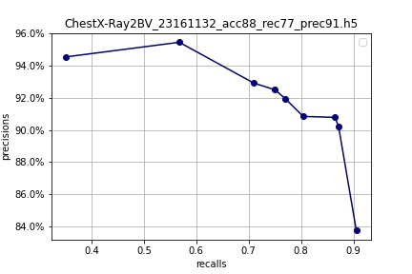
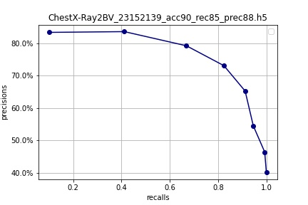
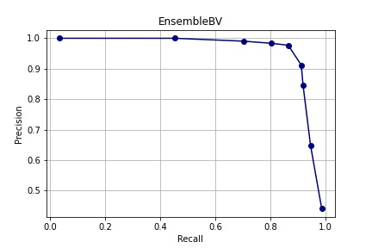
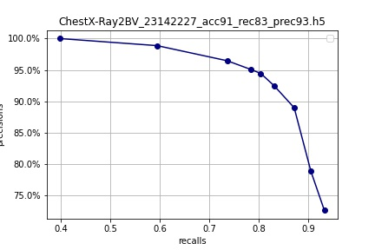

Comparison – PR curve
AP = 0.9151
AP = 0.6568
Mobilenet
ResNet50
AP = 0.8664
Ensembled
AP = 0.9094
AP = 0.6562
ResNet152V2
Self-build CNN

Slide 25
Result
Becteria
Virus

Slide 26
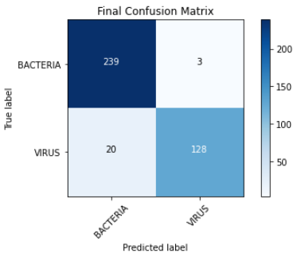
Result
Becteria
Virus

Slide 27
Result
Becteria
Virus
Pneumonia…
Becteria
X-ray Image
Virus
Normal!

Slide 28
Future Outlook
Process | Present Problem | The Way to Improve
Data Source | Resolution of X-ray imaging affects the accuracy of prediction. | Choose clear X-ray images.
Classification | Only divided into "Virus" & "Bacteria" when pneumonia is predicted. | Classify specific pathogens ( e.g. tuberculosis ) or virus type
Prediction | Unable to handle the coexistence of viruses and bacteria. | Use Normal / Becteria & Normal / Virus to classify.
Ensembling | Extreme results affect the average. | Choose "vote" as the ensembling way but not "average".
Competitiveness | No other ready-made model to compare. | Compare with the result of the one generated by Teachable Machine.

Slide 29

Future Outlook
Medical history
Prediction Models
CADx
Symptom
Medical Images

Slide 30
Reference
https=//www.kaggle.com/datasets/paultimothymooney/chest-xray-pneumonia/code
https=//www.kaggle.com/code/karnikakapoor/pneumonia-diagnosis-convnet-model
https=//www.kaggle.com/code/madz2000/pneumonia-detection-using-cnn-92-6-accuracy
https=//www.kaggle.com/code/alisultanov/pneumonia-diagnosis-using-resne
https=//www.kaggle.com/competitions/vinbigdata-chest-xray-abnormalities-detection/data
https=//medlineplus.gov/xrays.html
https://time.com/6246045/collapse-us-health-care-system/
https://www.scielo.br/j/rsbmt/a/98LMbshKyrXVc7sC4nZwkSG/?lang=en
https://finance.yahoo.com/news/global-health-care-collapse-190439531.html

